Slide 1
Viruses
Chandler Calkins & Gabriel Jones

Slide 2
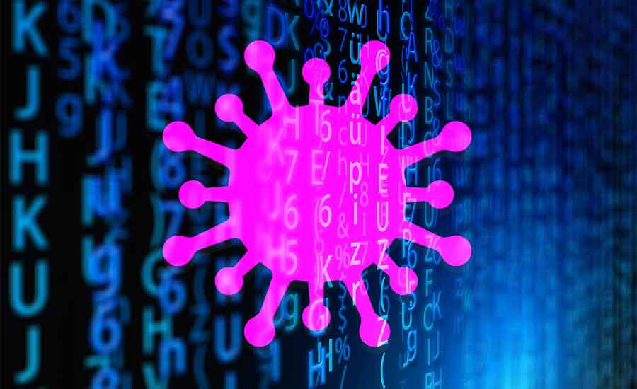
Outline
Introduction / Recap of viruses
What is a Virus?
Parts of a Virus
Brief History of Viruses
How to make a virus
How to make Anti-Virus software

Slide 3
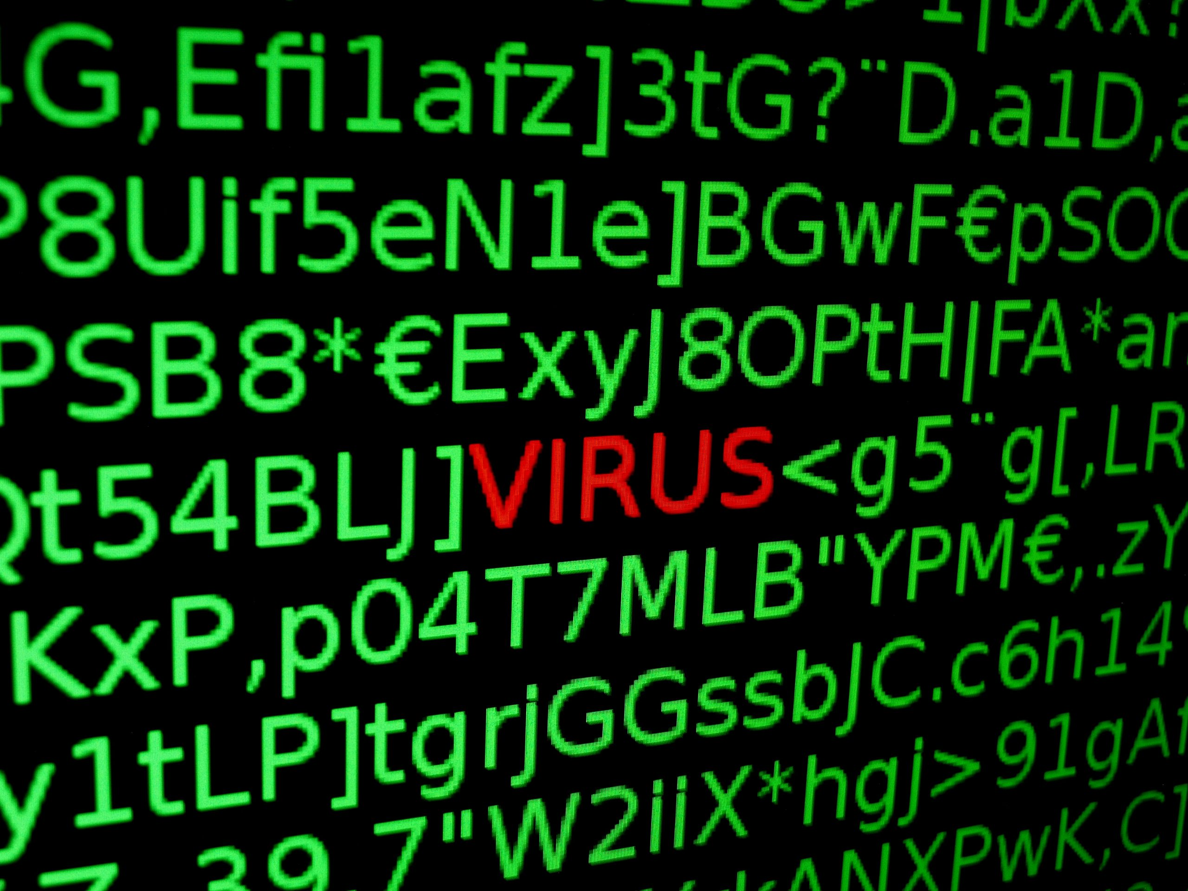
What is a Virus?
A malicious program that overwrites other programs
Can either completely replace, or carefully insert code into other programs
Infected programs can be infected with code that makes them infect even more programs

Slide 4
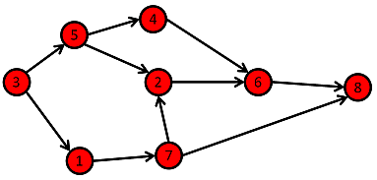
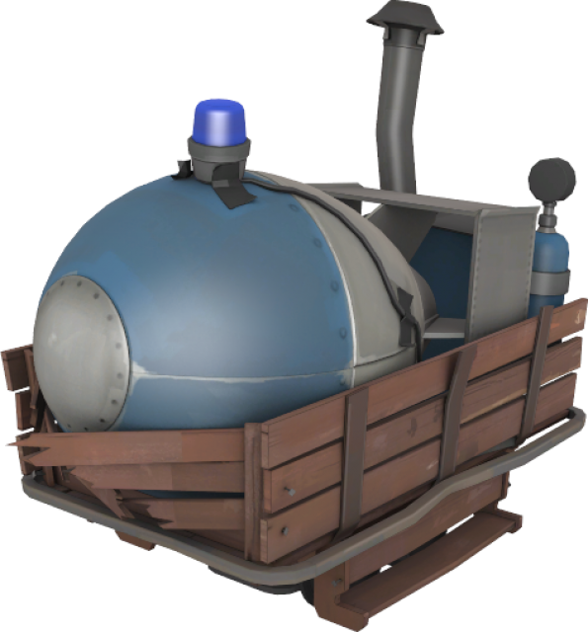

Parts of a Virus
Infection Mechanism
How will the virus get into and spread through a system?
Payload
What will the virus do to the system in addition to spreading itself?
Trigger
When will the virus activate, and what will cause it to activate?

Slide 5
Brief History of Viruses
Very early viruses weren’t the smartest - but they were extremely effective
Writing zeros to boot partitions/bios instructions
Filling up a drive over time to be annoying
Deleting random files
More modern viruses tend to incorporate other types of MALWARE
Can be much more specifically targeted
If attack is successful, result(s) can be catastrophic
Ransomware/Data encryption/Personal information digging
Phishing emails
Secrecy/Undetection (self encryption/mutations)

Slide 6
How to Make a Virus

Slide 7
How to make a Virus
Step 1: Find which programs you want to infect
Step 2: Determine where you want to place the payload in each file
Step 3: Create the payload / infection mechanism
Step 4: Write the payload to the files you want to infect

Slide 8
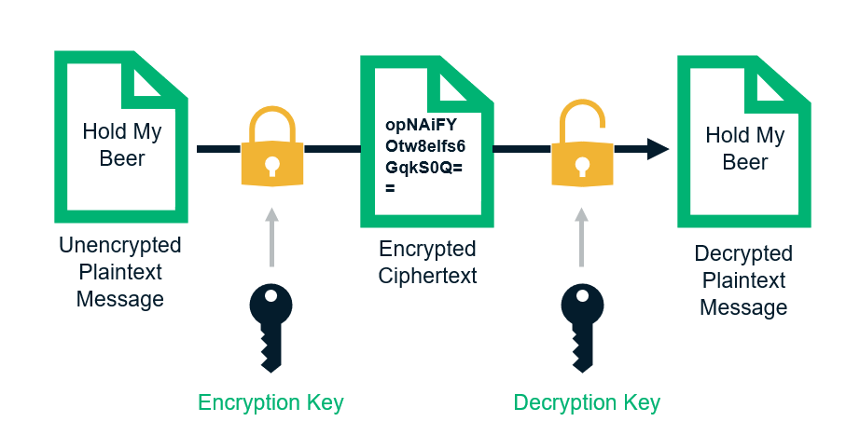
Polymorphism
Same payload every time is easy to detect
Lots of ways to randomize the payload
Most popular way is using encryption:
1. Take your payload and turn it into a string
2. Get a random key and encrypt your payload
3. Make it so infected files decrypt that string back into code, and then execute it

Slide 9
Parts of this Virus
Infection mechanism:
Just the root virus program infecting as many python files as it can
Payload:
Makes the keyboard unusable + slightly lags the computer
Trigger:
Running any infected program

Slide 10
How to Make an Anti-Virus

Slide 11
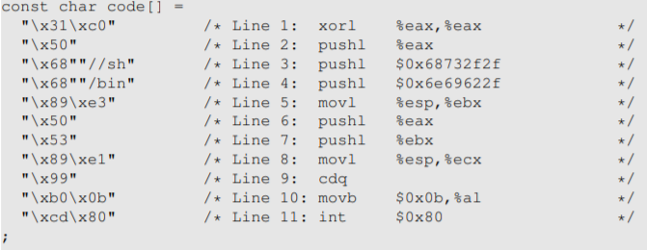
How to make Anti-virus software
Which is more effective?
Why?
Generally 2 main ways
Behavioral/Pattern/Action Recognition
Several files all running the exact same code? Changing by the same length?
One program scrubbing large amounts of files?
Payload (key terms/code) Searching
Recall our buffer overflow lab
We took advantage of a vulnerability to run this malicious shellcode --------------------------->
These known payloads can be stored in a remote server and added to when more are found

Slide 12
Outline
Introduction / Recap of viruses
What is a Virus?
Parts of a Virus
Brief History of Viruses
How to make a virus
How to make Anti-Virus software

Slide 13
Sources + Questions?
http://etutorials.org/Misc/computer+book/Part+2+Dangerous+Threats+on+the+Internet/Chapter+7+Viruses+and+Worms/HOW+VIRUSES+AVOID+DETECTION/
https://www.youtube.com/watch?v=2Ra1CCG8Guo
https://www.youtube.com/watch?v=-TSWzErSxC4
calk9614@vandals.uidaho.edu
jone1291@vandals.uidaho.edu

